Slide 1
11055 / Programming for Design
30 September 2019 / Semester 2 Week 9
Programming for design
Week 9 – Languages
Simon Thompson

Slide 2
11055 PfD
30/9/19 – S2W9
Week 7
We looked at how to produce quality code
Looked at some types of unit tests

Slide 3
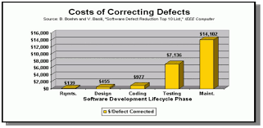
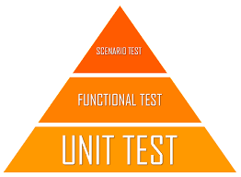
11055 PfD
30/9/19 – S2W9
Testing

Slide 4
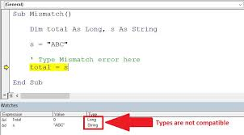
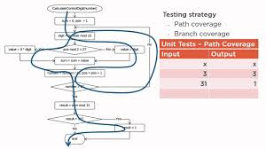
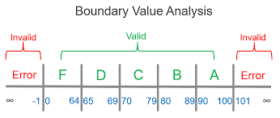
11055 PfD
30/9/19 – S2W9
Unit testing types
Data type testing
Boundary Testing
Code Coverage

Slide 5
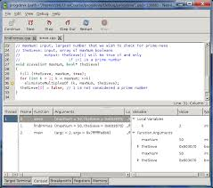
11055 PfD
30/9/19 – S2W9
Debugging
Reading your code
Commenting you code
Putting log/output statements everywhere
Debuggers
Watch/Break Points/Step

Slide 6
11055 PfD
30/9/19 – S2W9
Why are we here?
Course Objectives
Identify and critique various programming languages and how they can be utilised within the field of design;
Analyse and apply computer programming techniques through the use of features including loops, variables, functions and objects; and
Create engaging interactive media for different various contexts.

Slide 7



11055 PfD
30/9/19 – S2W9
Quiz
Project 1
Project 2
20% Week 4
Mostly module 1, with maybe a variable question or five
30% Week 7
A JavaScript project using the tools we have learnt
50% Week 13
A Python project using the tools we have learnt

Slide 8
11055 PfD
30/9/19 – S2W9
Project 2 (assignment 3)
Your prototype will read a provided file that contains a list of book isbn numbers. Using python, it will then generate a html page(s) that displays information about the books in a format of your choosing.
Project will include the following:
Flow chart(s) detailing what your program will do.
Set of pseudo-code detailing what how your program will operate.
Python code that will read a file in the correct format, and output the appropriate html/css code that shows information on the books in the file.
To be submitted on GitHub, in the ./Project2/[your student number] directory structure

Slide 9





11055 PfD
30/9/19 – S2W9
Languages
Generations of computer languages have given us many different ways to program.

Slide 10
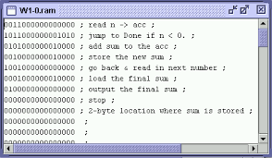
11055 PfD
30/9/19 – S2W9
1st Generation Languages
All in binary (0 and 1s) this is the language that computers themselves read, and what our modern languages ‘compile’ our code into so that the computer can read it

Slide 11
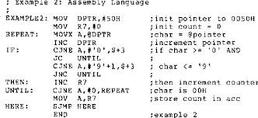
11055 PfD
30/9/19 – S2W9
2nd Generation Languages
These are usually named assembly or assembler languages.
This is still used to program the ‘kernel’ (the very core parts) of operating systems and how they work with the CPU.
Every different architecture (hardware design) requires a different assembler language to be used.

Slide 12
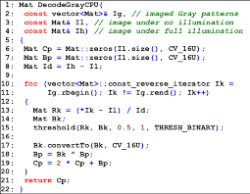
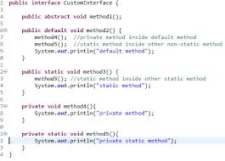
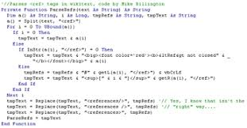
11055 PfD
30/9/19 – S2W9
3rd Generation Languages
These are usually called high level languages, as they are more focused on what needs to be done, rather than how it needs to be done.
Most people have heard about these languages with C++, Java, Visual Basic and JavaScript falling into this generation.

Slide 13
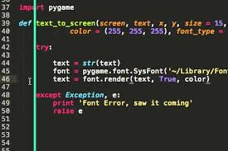
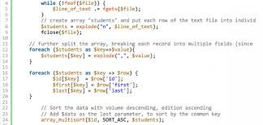
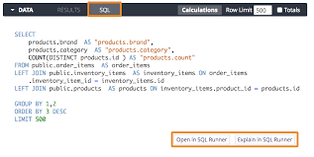
11055 PfD
30/9/19 – S2W9
4th Generation Languages
These look closer to ‘human’ language than all those mentioned previously.
SQL, Python, PHP are often used in modern applications.
Interestingly, as languages get simpler, programmers make them more complex through ‘short-cuts’.

Slide 14
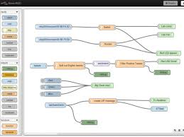
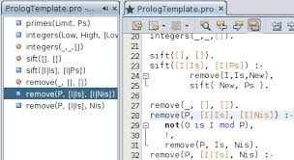
11055 PfD
30/9/19 – S2W9
5th Generation Languages
These visual languages, include ‘physical’ representations of code allowing more interaction with ‘non-programmers’

Slide 15
11055 PfD
30/9/19 – S2W9

Slide 16
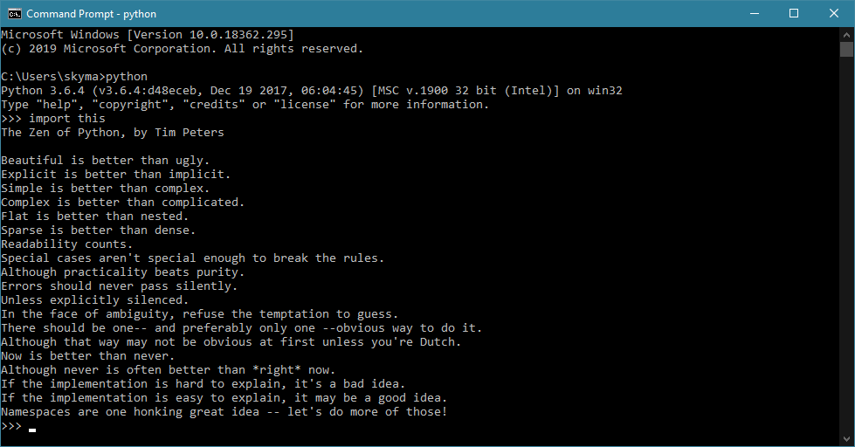
11055 PfD
30/9/19 – S2W9
Python
Python is a 4th Generation language that is built with the mindset that everything is an object.

Slide 17
11055 PfD
30/9/19 – S2W9
Python
Lets check if python is on your computer;
Open a command.exe or terminal window and type: python
If you see a message about python 3.x.x and a >>> prompt, then you have python already, otherwise
Lets install Python on your computer;
Go to www.python.org/downloads ; We want to install python 3

Slide 18
Exercise 1
11055 PfD
30/9/19 – S2W9
In your IDE create a file called helloworld.py (in your git exercise folder) and type in
print(“Hello World”)
Save it and run your file by
Windows
Open Explorer, navigate to the folder with the helloworld.py file in it.
Click in the address bar (at the top) and type -> cmd
At the prompt type -> helloworld.py
Or -> python3 helloworld.py
Mac
Open Finder, navigate to the folder with the helloworld.py file in it.
Right click and select open terminal
At the prompt type -> helloworld.py
Or -> python3 helloworld.py

Slide 19
11055 PfD
30/9/19 – S2W9
Comments
Scoping (Indenting)
# this is a comment
“””
This is a multi-line comment
“””
There are no { braces saying when statements and functions and classes start and end, it is all done on the spacing
def aFunction():
#this is part of the function
#this is not part of the function

Slide 20
11055 PfD
30/9/19 – S2W9
Create Variables
Value concepts
a = “” String
a = 1 Number
a = [“one”, “two”, “three”]
a = { “name” : “John”, “age” : “21” }
There are other types, do some research if you want to know more.
Redeclaring
a = 1 (a is a number)
a = “hello” (a is redeclared as a string)

Slide 21
11055 PfD
30/9/19 – S2W9
Variables forcing type
x = 1 # x is an int
a = float(x) # will convert x to a float to store in a
x = int(a) # will convert a to a int to store in x
There is also
st = str(x) # will convert x into a string to store in st
st = ‘hello’ # these are the same
st = “hello” # these are the same

Slide 22
11055 PfD
30/9/19 – S2W9
Variables, strings
st = “”” this is # you can also use ‘’’
going to be a multi-line
string“””
Strings are arrays by default
st = “hello”
print (st[4]) #this will print o (arrays start at 0)

Slide 23
11055 PfD
30/9/19 – S2W9
Comparison
Equal
Not Equal
Greater than
Greater than or equal to
Less than
Less than or equal to
==
!=
>
>=
<
<=
You can’t compare different types
e.g.
2 == “2”

Slide 24
11055 PfD
30/9/19 – S2W9
Logical Operators & Concatenation
And
Or
Not
String Concatenation
and
or
not
+

Slide 25
Exercise 2
11055 PfD
30/9/19 – S2W9
In your IDE create a file called helloworld2.py (in your git exercise folder) and type in
str_hello = “Hello”
str_world = “World”
print(str_hello + str_world)
print(str_hello, str_world)
Clean up any issues with formatting of your strings

Slide 26
11055 PfD
Exercise 3
30/9/19 – S2W9
Take one of your early JavaScript pieces of code and rewrite it into Python

